Slide 1
CRITICAL VALUES ARE CRITICAL TO THE LABORATORY
Peter J. Howanitz MD
Professor & Vice Chair
SUNY DOWNSTATE
Brooklyn, NY, USA
Peter.Howanitz@downstate.edu

Slide 2
INTRODUCTION
Definition Of Critical Values
Critical Values Practice Patterns
Characteristics Of Critical Values
Development Of Critical Values
Conclusions

Slide 3
DEFINITION CRITICAL VALUES
“Representing a pathophysiological state at variance with normal as to be life threating unless something is done promptly”
Not Convenience Values
Importance

Slide 4
EXAMPLES OF CRITICAL VALUES
ANALYTE | LOW CRITICAL VALUE PERCENTILE |  |  | HIGH CRITICAL VALUE PERCENTILE
 | 10TH | 50TH | 90TH | 10TH | 50TH | 90TH
Calcium (mg/dL) | 6.0 | 6.0 | 7.0 | 12.0 | 13.0 | 14.0
Sodium (mmol/L) | 110 | 120 | 125 | 150 | 160 | 170
Potassium (mmol/L) | 2.5 | 2.8 | 3.0 | 6.0 | 6.2 | 6.5
Glucose (mg/dL) | 40 | 40 | 50 | 300 | 450 | 700
Hematocrit (%) | 15.0 | 20.0 | 25.0 | 55.0 | 60.0 | 65.0
Howanitz et al. Arch Pathol Lab Med 2002:126:663-666
Notes:
First of three slides. Chemistry and Heme values reported-long list of values, and only have taken 5
Point out studies are according to percentiles and that many analytes have high and low critical values. N =623 – Absolute values are listed

Slide 5
Reporting Microbiology Criticals
MICRIBIOLOGY RESULT | % Participants
Positive Blood Culture | 95.0
Positive CSF Cultures | 91.2
Positive AFB Smear Or Culture | 71.9
Positive Gram Stain Sterile Body Fluid | 66.8
Initial Stool Isolate, Salmonella, Shigella, Yersinia, Campylobacter | 59.7
Positive Latex Agglutination &/Or Antigen Detection Test | 25.7
Other Microbiology Critical Values | 44.8
Notes:
Positive blood culture, CSF culture, AFB smears, Sterile body fluid positive gram stain and Initial stool isolate for Salmonella, shigella, etc.
Some other critical values not in place in the majority of clinical labs

Slide 6
DRUG REPORTING PRACTICES
DRUG RESULTS | PARTICIPANTS %
Drugs of Abuse
Reported All Positives | 25.2
Do Not Report All Positives | 52.8
Not Applicable | 22.0
Therapeutic Drugs
Reported All Toxic Values | 96.3
Do Not Report All Toxic Values | 2.9
Not Applicable | 0.8
Notes:
Toxic therapeutic Drug levels reported by almost all
Most do not report drugs of abuse

Slide 7
TIME TO COMPLETE CALL (N=599)
 | MEAN TIME TO COMPLETE CALL (Min)
 | INPATIENTS |  |  | OUTPATIENTS
# Beds | Night | Evening | Day | All Shifts
1-150 | 7.0 | 10.1 | 8.1 | 13.2
151-300 | 5.7 | 5.8 | 5.9 | 11.4
301-450 | 5.4 | 6.0 | 7.5 | 21.2
451-600 | 2.9 | 3.4 | 4.0 | 9.5
>600 | 3.1 | 4.7 | 3.3 | 9.3
All | 5.3 | 6.5 | 6.4 | 13.7
Notes:
Over 30 days partiicpants made 275,000 calls and recorded data for 12,930 calls.
Depends on shift, inpatients or outpatients and hospital size.
Distribution is skewed to more time.

Slide 8
TIME TO ABANDON CALL (N=133)
 | MEAN TIME TO ABANDON CALL (Min)
 | INPATIENTS |  |  | OUTPATIENTS
# Beds | Night | Evening | Day | All Shifts
1-150 | 9.8 | 46.6 | 54.8 | 23.4
151-300 | 3.5 | 7.3 | 7.5 | 27.2
301-450 | 15.7 | 36.4 | 6.4 | 108.6
451-600 | 0.8 | 0.5 | 6.1 | 28.3
>600 | 15.0 | 13.3 | 0.0 | 34.2
All | 8.5 | 25.3 | 23.9 | 46.3
Notes:
Differs by shift and by inpatients vrs outpatients.

Slide 9
PERSONNEL INVOLVED IN CRITICAL VALUES
 | INPATIENTS (% OF TOTAL) | OUTPATIENTS (% OF TOTAL)
REPORTING PERSONNEL
Person Performed Test | 91.0 | 77.3
Section Supervisor | 2.6 | 3.9
Laboratory Clerk | 5.6 | 17.2
Other | 0.8 | 1.6
RECEIVING PERSONNEL
Registered Nurse | 37.8 | 21.2
Any Staff Nurse | 18.1 | 13.3
Unit Clerk/Office Staff | 12.5 | 42.1
Medical Student | 0.2 | 0.1
Physician On Call | 3.6 | 6.7
Physician Ordering Test | 8.6 | 16.7
Notes:
Person performing test reported values, and RN most commonly received call.

Slide 10
REPEAT CRITICAL VALUES
POLICY | PARTICIPANTS (%)
No Policy On How Handled | 71.4
Repeat Values Not Called | 11.6
Values Not Called On Physician Request | 6.8
Seek Physician Permission To Not Call | 1.9
Have Preset Policy On Number Of Calls | 1.8
Seek Physician Permission Not To Call After Preset # Of Calls | 0.3
Use Another Policy | 6.1

Slide 11
PERCEPTION CRITICAL VALUE NOTIFICATION
FINDING | 5426 Charts Reviewed | 4737 Physicians Surveyed
Critical Value Anticipated (%) | 54.3 | 59.3
Critical Value Influenced Therapy | 64.9 | 62.9
Test Reordered | 66.3 | 43.3
Found In Nursing/Progress Notes | 75.5
Notes:
Almost 60% critical values anticipated, and over 60% of critical values influenced therapy.
Most common response was to repeat value.

Slide 12
PERCEPTION CRITICAL VALUE POLICY
LOCATION | RESPONDERS | % List Is Valid Indicator | % Calls Helpful
ED | 575 Nursing Supervisors | 16.7 | 19.1
ICU/CCU | 576 Nursing Supervisors | 23.3 | 27.6
Medicine/Surgery | 576 Nursing Supervisors | 33.4 | 40.8
Other Stations | 574 Nursing Supervisors | 16.2 | 20.6
Hospital | 514 Physicians | 78.6 | 94.9

Slide 13
SOURCE CRITICAL VALUE POLICY
Literature Review Only Includes Manufacturer’s Help | 18.0%
Literature Review Including Manufacturers’ Help & Lab Meetings | 36.0%
Literature Review Modified By Hospital Committee Includes In-House Studies | 16.8%
Literature Review Modified By In-House Studies and Medical Staff Consultations | 72.7%

Slide 14
CAP CHECKLIST CRITICAL RESULT NOTIFICATION 2013
The laboratory has procedures for immediate notification of a physician (or other clinical personnel responsible for the patient’s care) when results of designated test exceed established “alert” or “critical “ values that are important for prompt patient management decisions. COM. 30000 Phase II
Notes:
Study Presented resulted in more emphasis on Critical values in checklist.

Slide 15
CAP CHECKLIST CRITICAL RESULT NOTIFICATION
When critical results are communicated verbally or by phone, there is a policy that laboratory personnel ask for a verification “read-back” of the results. COM30100 Phase I
Note: Laboratory personnel should document the read-back.
Evidence of Compliance: Records of critical result notification with documented read-back.

Slide 16
2013 THE JOINT COMMISSION NATIONAL PATIENT SAFETY GOAL 2
Critical Results Procedure
  Definition Of Critical Values
  By Whom & To Whom Results Delivered
  Acceptable Time To Report
Implement Procedures For Critical Values
Evaluate Timeliness Of Reporting
Notes:
Study also resulted in TJC making critical values a National Patient Safety Goal.

Slide 17
TEMPLATE FOR READ BACK OF CRITICAL VALUES
[CALLER: Technologist]:
I am calling to inform you of a critical result for a laboratory test performed for patient [NAME/MR #].
To ensure patient safety & verification of the correct test result, we require that you WRITE DOWN and READ BACK the laboratory test result you are about to receive.
Notes:
We have learned that it is important to provide a script for our technologists who then record this info in the laboratory computer.

Slide 18
HOW TO DETERMINE CRITICAL VALUES
1. CHOOSE ANALYTE
TOTAL SERUM AND WHOLE BLOOD SODIUM RESULTS/ 6 MONTHS
Number Of Results
Total Sodium Results | 111,545
Critically Low Results ( ≤125 mmol/L) | 166
Critically High Results (≥150 mmol/L) | 447
Total Critical Results (% Of Total) | 613 (0.5)
Howanitz et al. Am J Clin Pathol 2007:127:56-59
Notes:
We looked to have our patients at another institution and have same critical values for our physicians. Becomes important with consolidation.

Slide 19
HOW TO DEVELOP CRITICAL VALUES:DATA COLLECTION
SODIUM RESULTS (MMOL/) | # RESULTS | # PATIENTS
 | LOW
≤115 | 85 | 25
116-120 | 94 | 46
121-125 | 624 | 431
 | HIGH
150-154 | 45 | 37
155-159 | 274 | 70
≥160 | 175 | 31
Notes:
125 and 150 mmol/L were in the top 10% of labs choosing value
Distribution is different. Most calls for low sodium, with higher values a different distribution.
If we could eliminate the 121-125 mmmol/L calls, it would free up over two workdays of time for a technologist in a year.

Slide 20
HOW TO DEVELOP CRITICAL VALUES:OUTCOMES
SODIUM (MMOL/L) | # PATIENTS
HYPONATREMIC | 62
116-120 & Died | 10
111-115 & Died | 2
≤110 & Died | 0
Total Died | 12 (19%)
HYPERNATREMIC | 97
155-159 & Died | 36
160-164 & Died | 6
≥ 165 & Died | 5
Total Died (% of Patients) | 47 (48%)

Slide 21
HOW TO DETERMINE CRITICAL VALUES
2. DETERMINE PATIENT DEMOGRAPHICS
 | Critically Low Results | Critically High Results
Our Current Critical Value | ≤ 120 mmol/L | ≥ 160 mmol/L
Number Of Patients | 71 | 101
Age Range | <1-92 | <1-90
Number Of Outpatients | 9 | 4
Number Of Inpatients | 62 | 97
Length Of Stay ≥ 6 d (% Of Patients) | 40 (65) | 82 (85)

Slide 22
HOW TO DETERMINE CRITICAL VALUES
3. EVALUATE DIFFERENT VALUES
SODIUM RESULTS (mmol/L) | TIME OF ACTION (HOURS) | NUMBER OF PATIENTS
116-120 | 0-4 | 18
 | 4-24 | 15
 | >24 | 0
 | None | 2*
111-115 | 0-4 | 16
 | 4-24 | 2
 | >24 | 0
 | None | 0
≤ 110 | 0-4 | 5
 | 4-24 | 5
 | >24 | 2
 | None | 0
*-Died

Slide 23
HOW TO DETERMINE CRITICAL VALUES
3. EVALUATE DIFFERENT VALUES
SODIUM RESULTS (mmol/L) | TIME OF ACTION (HOURS) | NUMBER OF PATIENTS
155-159 | 0-4 | 46
 | 4-24 | 15
 | >24 | 0
 | None | 3*
160-164 | 0-4 | 46
 | 4-24 | 9
 | >24 | 0
 | None | 0
≥165 | 0-4 | 9
 | 4-24 | 5
 | >24 | 0
 | None | 1*
*-Died

Slide 24
HOW TO DETERMINE CRITICAL VALUES
4. IDENTIFY VALUES IN DEATH
SODIUM RESULTS (mmol/L) | NUMBER OF PATIENTS
HYPONATREMIA (n=62)
116-120 | 10
111-115 | 2
≤110 | 0
Died (% of patients) | 12 (19)
Hypernatremia (n=97)
155-159 | 36
160-164 | 6
≥165 | 5
Died (% of patients) | 47 (48)

Slide 25
HOW TO DETERMINE CRITICAL VALUES
5. REVIEW DATA & DETERMINE VALUE
SODIUM RESULTS (mmol/L) | NUMBER OF RESULTS | NUMBER OF PATIENTS.
Hyponatremia
≤115 | 85 | 25
116-120 | 94 | 46
121-125 | 624 | 431
Hypernatremia
150-154 | 45 | 37
155-159 | 274 | 70
≥160 | 175 | 31

Slide 26
GREATEST REPORTING OBSTACLES
OBSTACLE | RESPONSES | % OF TOTAL
Providers Not Returning Calls/Pages | 365 | 74.6
Getting Person To Accept Result | 27 | 5.5
Reporting To Covering Physicians | 24 | 4.9
Incorrect Provider Contact Information | 23 | 4.7
Caregiver Unwilling To Read Back | 21 | 4.3
Placed On Hold Awaiting Caregiver | 18 | 3.7
Too Long A List Of Critical Values | 5 | 1.0
Reporting Interrupts Technologist Work Flow | 4 | 0.8
Discharged Patients | 2 | 0.4
Total | 489 | 100
Dighe et al Arch Pathol Lab Med 2008:132:1666-1671.

Slide 27
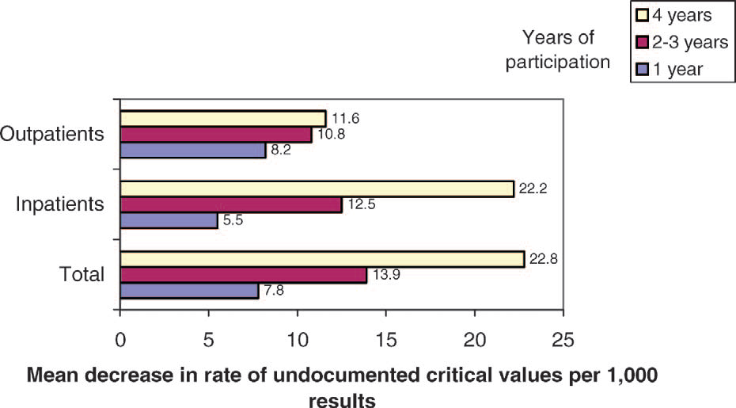
ABANDONED CRITICAL VALUES
Wagar et al Arch Pathol Lab Med 2007:131; 44-49.

Slide 28
CRITICAL VALUES AUTOMATED
Used at Some Hospitals
Requires Use of Up To Date On-Call Schedules
Eliminated Many Problems
Transfers Results Mobile/Communication Devices
Acknowledgement Of Receipt

Slide 29
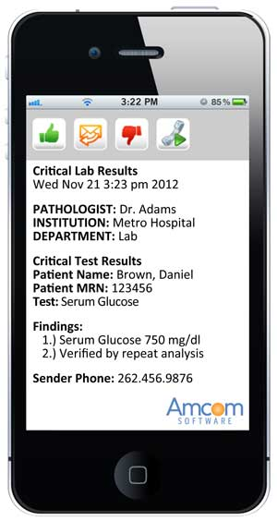

Slide 30
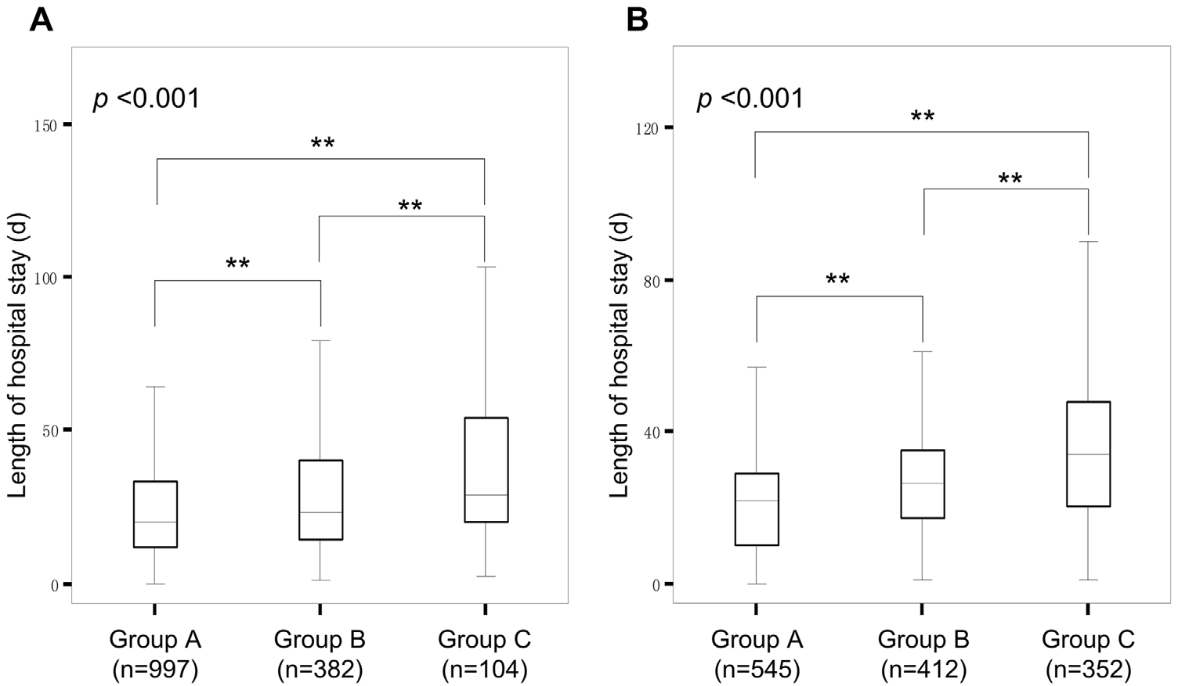
CRITICAL VALUES IN CHINA HOSPITAL
Potassium
Potassium & # Repeat Critical Values
Platelet Count & # Repeat Criticals
Yang et al. PLoS ONE 2013:8: e59518

Slide 31
SURGICAL PATHOLOGY CRITICAL VALUES
CONTROVERSIAL
  What Are The Critical Results?
  Communication Problems?
  Variable Standards Of Practice?
  Waste Of Pathologists Time?

Slide 32
11 PROPOSED SURGICAL PATHOLOGY CRITICAL VALUES
Bacteria In A Heart Or Bone Marrow Specimen
Select Organisms In Immunocompromised Patients
Fat In An Endometrial Curettage
Transplant Rejection
Crescents In <50% Of Glomeruli In a Kidney Biopsy Specimens
Mesothelial Cells In A Cardiac Biopsy Specimen
Uterine Contents Without Villi Or Trophoblast
Neoplasms Causing Paralysis
Malignancy In Superior Vena Cava Syndrome
Fat In colonic endoscopic polipectomy specimen
Vasculitis
Pereira et al. Am J Clin Pathol 2008;130: 731-35.

Slide 33
10 PROPOSED CYTOLOGY CRITICAL VALUES
Bacteria/Fungi in CSF immunocompromised
Bacteria/Fungi in CSF
Pneumocystis, fungi, viral cytopathic changes in BAL, wash, brush specimen Immunocompromised
Malignancy in critical place
Pneumocystis, fungi, viral cytopathic changes in BAL, wash, brush specimen
Acid Fast bacilli in any specimen
FNA-Disagreement immediate & final diagnosis
Fungi in FNA immunocompromised
Completely unexpected malignancy
Acid Fast bacilli any specimen immunocompromised

Slide 34
RADIOLOGY CRITICAL VALUES
Agreement On What Constitutes Critical Value
Joint Commission Requirements Same As Path
Research On Automatically Extracting Critical
Values

Slide 35
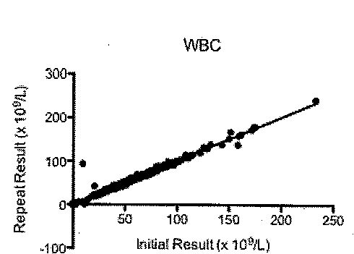
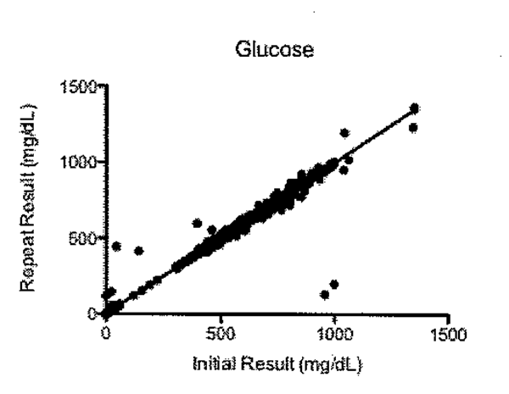
SHOULD CRITCAL VALUES BE REPEATED?
Lehman et al. In Press Arch Pathol Lab Med

Slide 36
CONCLUSIONS
Definition Of Critical Values
Critical Values Practice Patterns
Characteristics Of Critical Values
Development Of Critical Values
Problems Of Handling Critical Values

